Slide 1

Lesson 7: Comprehensive Site Audit (Informational Website)
Kubilay Cagatay
WEB 225

Slide 2
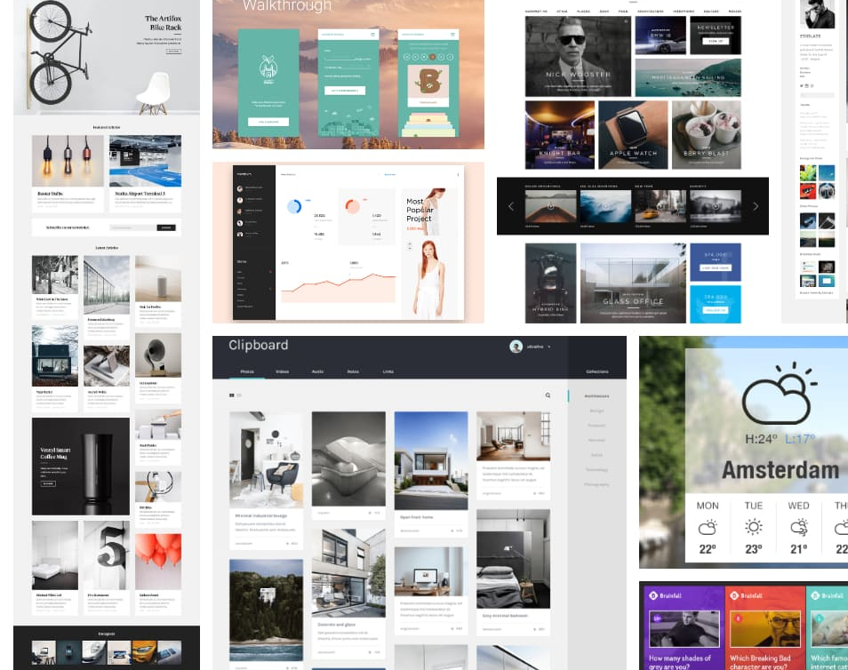
Informational Websites
Informational websites are those sites which are created in order to provide a customized and branded resource for potential and active customers, members, investors and so forth. These websites are usually content and design driven. (https://www.elinkdesign.com/web-services/web-design/web-design/informational-web-sites)
Some examples of Informational Websites:
IMDB.com
WebMD.com
Britannica.com
Howstuffworks.com

Slide 3

Website Audit
Like a hotel room key that opens one and only one door for a limited amount of time
Tells someone what a website looks like at a particular time
A checkup that shows what is lacking in terms of content, SEO, design, and usability (https://www.adcisolutions.com/knowledge/how-conduct-website-audit-beginners-guide)

Slide 4

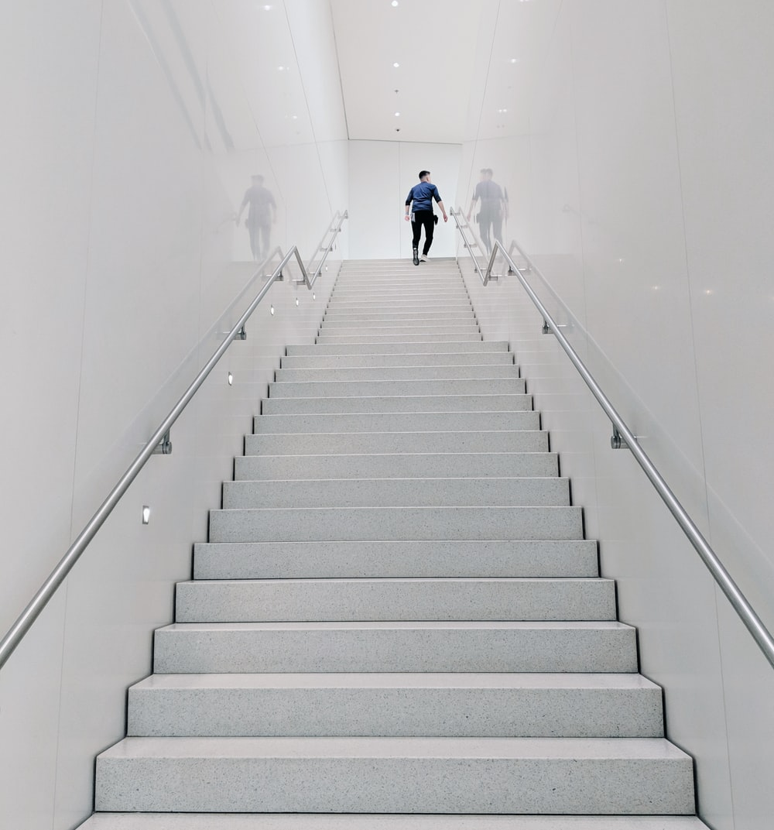
Steps to take to prepare to audit
15 minute audit – familiarize yourself with the state of the website as a whole
2 hour SEO best practice run-through
Google Webmaster Tools – get an external perspective on the website
SEO Scorecard – fill out report to give to the client

Slide 5
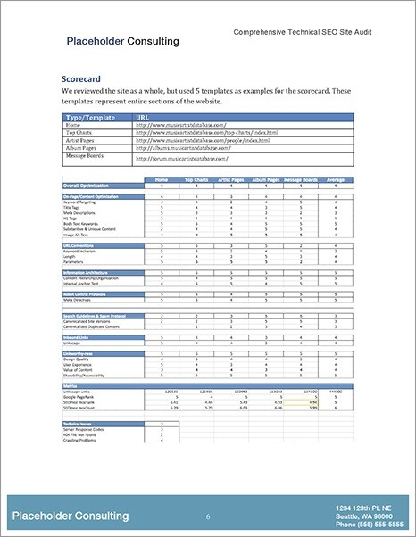
SEO Scorecard
Abbreviated version of the full SEO analysis
Important SEO metrics are rated on a scale of 1 to 5
This makes it easy for the client to prioritize the most important fixes first

Slide 6
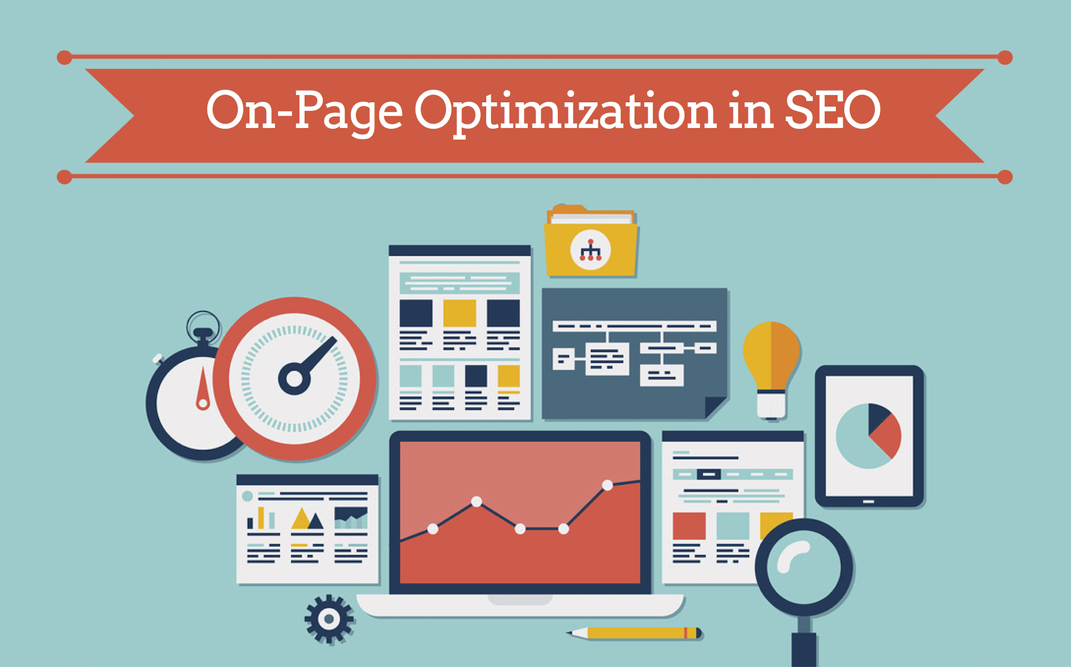
Sections of the Audit: On-Page/Content Optimization
This is the material that users come to see when they go to the website
Should be designed primarily for people, not search engines
Some common problems associated with this: Title Tags, Meta Descriptions, Image Alt Attribute

Slide 7

Sections of the Audit: URL Conventions
URLs are made unique to make sure that each page on a website has a unique URL
Makes it easy for programmers but hard for visitors or search engines to know what is on a specific page
Some common problems associated with this: Keyword Inclusion, URL length and URL parameters

Slide 8
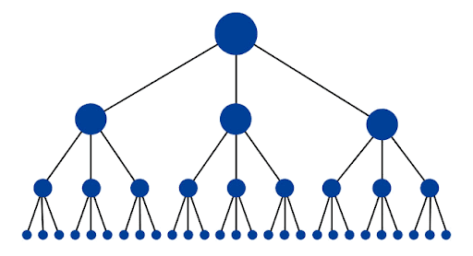
Sections of the Audit: Information Architecture
As websites grow, the map of the site and its subpages gets confusing
Information needs to be organized so anchor text is used to link internal pages
Some common problems associated with this: Content Hierarchy/Organization and Internal Anchor Text

Slide 9

Sections of the Audit: Technical Issues
All the server and crawler errors that are encountered during the audit
Easy to implement list of fixable issues
Some common problems associated with this: 404 page, 500 server error, crawling problems

Slide 10

After Completing the Report
Provide client with a PDF version and send a printed out version
Go over the report with the client (by phone or in person)
Make sure the client understands next steps

Slide 11
Thank you!

